Slide 1
Disease Detection using ML
Presented By:
KRISHAN CHAUHAN
The "Disease Detection Using Machine Learning" project uses computers to find diseases early. It analyzes health data like test results or images to detect conditions like cancer or diabetes.
The system learns patterns from data to help doctors diagnose faster and more accurately. Tools like Python and TensorFlow are used to build and test the model.
This project improves healthcare by saving time, reducing errors, and supporting early treatment, which can save lives.

Slide 2
Content
Introduction
Abstract
Problem Statement
Objective
Hardware And Software Requirements.
Tools and Technology
Purpose of a project
Screenshots
Future Scope
Conclusion

Slide 3
Introduction
Disease detection is an important aspect of modern healthcare. Early detection and diagnosis of diseases can significantly improve patient outcomes and reduce healthcare costs.
Traditional methods of disease detection, such as manual diagnosis by medical professionals, have limitations in terms of accuracy and efficiency.
With the emergence of machine learning (ML) technology, there is an opportunity to develop more effective disease detection methods that can leverage large datasets and advanced algorithms to improve accuracy and efficiency.

Slide 4
Abstract
We propose a model that uses ML algorithms to detect diseases accurately and efficiently. We have trained our model on a dataset of medical records and have tested it on real-world data. The results have shown that our model has achieved high accuracy and has the potential to be used in clinical settings. The use of ML in disease detection can greatly improve the efficiency and accuracy of the diagnosis, enabling early detection and treatment, and ultimately improving patient outcomes.

Slide 5
Problem Statement
The current healthcare system faces challenges in accurately and efficiently detecting diseases. This can lead to delayed treatment, incorrect diagnoses, and poor patient outcomes.
Our project aims to address these challenges by leveraging the power of machine learning algorithms to automate the analysis of patient data and provide fast and accurate disease detection.

Slide 6
Objectives
Accurate and efficient detection of diseases in patients
Early detection and diagnosis of diseases, leading to improved patient outcomes
Incorporation of various factors such as medical history, lifestyle, and genetic predisposition into disease detection models, leading to more accurate predictions
A user-friendly interface that medical professionals can use to input patient data and receive disease predictions from the model
Potential to revolutionize healthcare and improve clinical practice by leveraging machine learning technology for disease detection.

Slide 7
Hardware and Software Specification
Python Programming language.
Libraries of python: Tkinter, pandas, numpy, sklearn.
MongoDB as the data platform.
Operating System- Microsoft Windows(any)
RAM – 2GB Minimum
Processor- 1 Ghz Minimum with Dual Core.

Slide 8
Tools and Technology
VS Code: It is a versatile code editor that supports multiple programming languages and integrates with popular machine learning frameworks. It offers intelligent suggestions, debugging tools, and extensions, making it efficient for coding.
MongoDB: In our project, MongoDB can be used to store patient data in a document-oriented format, enabling efficient retrieval and processing of large volumes of unstructured data for machine learning algorithms.

Slide 9
The Purpose of our Project
Use machine learning algorithms to quickly and accurately analyze patient data.
Assist medical professionals in making informed decisions and providing better care for their patients.
Reduce the number of unnecessary tests and procedures, thus lowering healthcare costs.
Increase the accuracy of diagnoses and reduce the likelihood of misdiagnoses and subsequent complications.
Make healthcare more efficient and accessible for all.

Slide 10
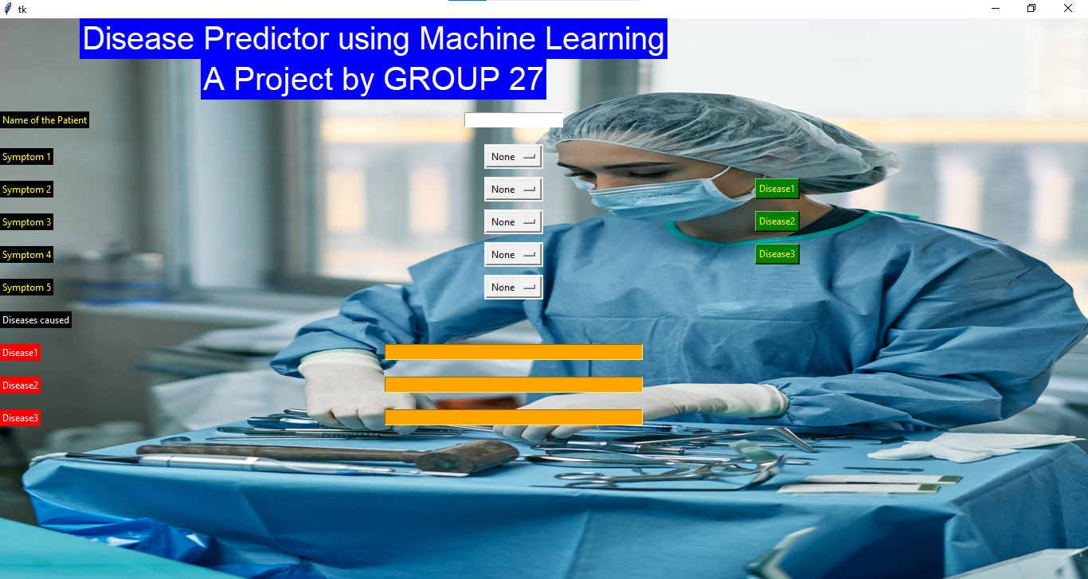

Slide 11
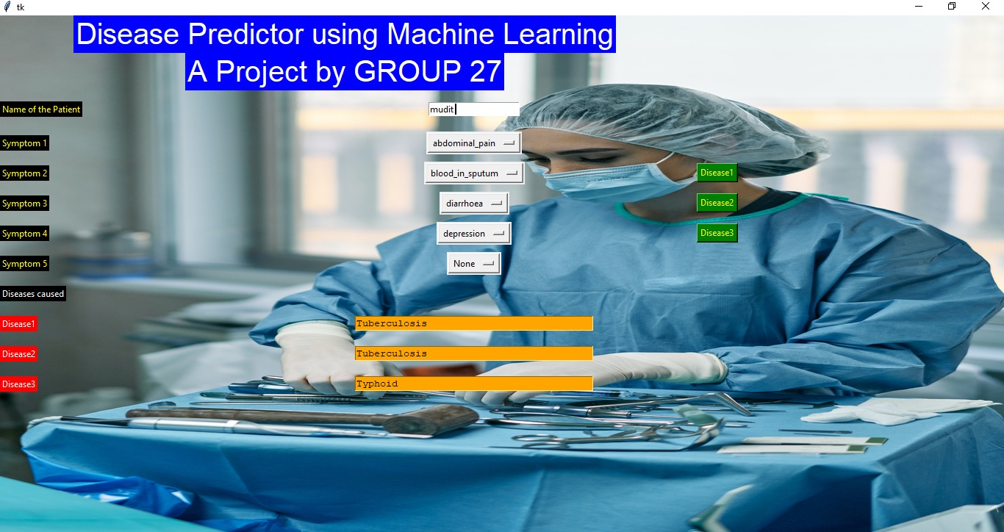

Slide 12
Future Scope
Development of mobile applications that can use the disease detection model to enable self-diagnosis and self-monitoring of diseases
Expansion of the disease detection model to include rare diseases and diseases that are difficult to diagnose using traditional methods
Integration of the disease detection model with wearable technology such as fitness trackers and smartwatches to enable continuous monitoring of disease risk factors and early detection of diseases
Collaboration with pharmaceutical companies to develop personalized treatment plans based on disease detection models
Continuous refinement and improvement of the disease detection model using feedback from medical professionals and patients.

Slide 13
Conclusions
The Disease Detection using ML project aims to improve disease detection and diagnosis in the healthcare system.
By using advanced machine learning algorithms, doctors and other medical professionals can analyze patient data quickly and accurately.
This can make healthcare more accessible and efficient for everyone, ultimately improving the quality of care provided to patients.

Slide 14


